Slide 1
Hadoop
Robert Evans, Nathan Roberts
Notes:
Introductions
ground rules – please ask questions – might here terms or yahoo’isms that don’t make sense – just call us out on those and we’ll explain
Heard of Hadoop
Have run a MapReduce job, Pig Job?
Use Hadoop on a daily basis?

Slide 2
First things first – Just in Time Compilation
$ sudo login hduser
$ cd Code/pig-0.12.1/
$ ﻿sudo JAVA_HOME=/usr/local/Java/jdk1.8.0_05/ ant -Dhadoopversion=23

Slide 3
Agenda
Hadoop Core Concepts
Architecture - HDFS – YARN – Map-Reduce
Q&A - Break
Developing Map-Reduce Programs + exercises
Q&A - Break
Problem Solving with Pig + exercises
Hadoop Ecosystem
Q&A
Notes:
Several presentations woven together

Slide 4
Hadoop Core Concepts

Slide 5

Internet Scale Generates BigData
Yahoo is the most Visited Site on the Internet
Hundreds of Millions of Unique Visitors per Month
Billions of Page Views per Day
Billions of Searches per Month
Billions of Emails per Month
Photos, IMs, Address Books, Buddy Lists, …
Terabytes of Data per Day!
…terabytes, 100s of terabytes, petabytes, 10s of petabytes…
Notes:
Billions and billions of everything
today module, trending, search, search assist, and of course advertisements

Slide 6


hadoop at
Yahoo
How Yahoo Uses Hadoop
PRODUCTS
Data Analytics
Content Optimization
Content Enrichment
Yahoo Mail Anti-Spam
Advertising Products
Ad Optimization
Ad Selection
Big Data Processing & ETL
DIMENSIONAL DATA
CONTENT
HADOOP CLUSTERS
Tens of thousands of servers
DATA PIPELINES
APPLIED SCIENCE
User Interest Prediction Ad inventory prediction
Machine learning - search ranking
Machine learning - ad targeting
Machine learning - spam filtering
Notes:
Front page isn’t the only place we use Hadoop. From customizing content across all of our properties, optimizing our advertising yields for our partners and protecting your email from spam and viruses, Hadoop’s flexibility and scale play a part in all of Yahoo.
Hadoop is also the platform that enables our scientists and data engineers to design the algorithms that power the next generation of Yahoo experiences.
Types of data being pushed into Hadoop is what makes it very exciting. Structure/semi-structured/completely unstructured – get the data in, THEN figure out how to make sense of it.

Slide 7

Data >> Information >> Value
Search Marketing
Model ad performance and query patterns
Use to improve ad and page relevance
Display & Contextual Advertising
Trace user activity to discover short- and long-term behavioral trends
Combine with demographic and geographic data to select far more targeted and effective advertisements
Connect People to Content
Build models from page views
Personalize pages via models (e.g., MyYahoo)
Increases engagement, which you then monetize
Notes:
7
Data -> Information -> Value -> More Data -> More Information -> More value

Slide 8
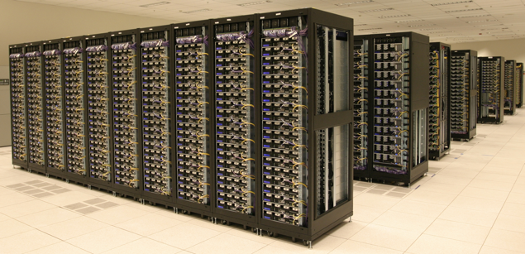
How to Process BigData?
Need to process large datasets (>100TB)‏
Just reading 100TB of data can be overwhelming
Takes ~11 days to read on a standard computer
Takes a day across a 10Gbit link (very high end storage solution)
On a single node (@50MB/s) – 23days
On a 1000 node cluster – 33min
Notes:
8
So how to process large datasets??

Slide 9
Not so easy…
Moving data from storage cluster to computation cluster is not feasible
In large clusters
Failure is expected, rather than exceptional. In large clusters, computers fail every day
Data is corrupted or lost
Computations are disrupted
The number of nodes in a cluster may not be constant. Nodes can be heterogeneous.
Very expensive to build reliability into each application.
A programmer worries about errors, data motion, communication…
Traditional debugging and performance tools don’t apply
Need a common infrastructure and standard set of tools to handle this complexity
Efficient, scalable, fault-tolerant and easy to use
Notes:
Can’t move data to compute

Slide 10
Enter Hadoop

Slide 11

Hadoop
Distributed Framework for processing and storing data generally on commodity hardware.
Completely Open Source.
Top level Apache project ‏
Available for download from Apache Hadoop website http://hadoop.apache.org
Written in Java
Runs on Linux, Mac OS/X, Windows, and Solaris.
Client apps can be written in various languages.
Latest released version of Hadoop – 2.4.x
Notes:
11

Slide 12
History of Hadoop
2002 – Nutch project began – Open source web search engine
2003/2004 – Google published GFS and MapReduce papers
2004/2005– Nutch developers created open source versions of these concepts
2006 – Doug Cutting joined Yahoo, MapReduce and the distributed file system moved out of Nutch to a separate project called Hadoop (named after kid’s stuffed elephant)
End of 2006 – 600 node clusters running in Yahoo
End of 2007 – 2x1000 node clusters running in Yahoo, other early adopters begin to use Hadoop
2008-2010 – Hundreds of companies begin using Hadoop as their distributed compute fabric
2009 – 24,000 nodes across many clusters running in Yahoo
2010 – MapReduce V2 is under major development
2012 – 40,000+ nodes running in Yahoo
2013 – Yahoo fully converted to MapReduce V2 (aka YARN)
Notes:
Was open source the right way to go for Yahoo? Yes!. If we hadn’t driven Hadoop within the community, I’m convinced there is no way we’d be at the scale we’re at today.
Keys that led to its success:
Java. Programmer capture. Has been thorny at times but majority of that is hidden within framework.
Stack grew quickly so that it became easier to use
Keep it simple – HA, tolerant of most faults, immutable files
Yahoo was fully committed to the platform, lot of resources dedicated to it, lots of applications moved to grid,

Slide 13
Features of Hadoop
Scalable: store and process petabytes, scale by adding Hardware
Economical: 1000’s of commodity machines
Efficient: run tasks where data is located
Reliable: data is replicated, failed tasks are rerun
Primarily used for batch data processing, not real-time / user facing applications
Notes:
13
Scalable – rebalances space automatically, takes advantage of new compute

Slide 14
Sample applications using Hadoop
For batch data processing (not real-time/user facing)
Log Processing
Reporting
Session Analysis
Building dictionaries
Click fraud detection
user clicks & view logs processing
Building Index
Site Rank
Machine Learning
Image classification
Mail spam filter creation
Notes:
14

Slide 15
Components of Hadoop
HDFS (Hadoop Distributed File System)‏
Modeled on GFS
Reliable, High Bandwidth file system that can
store PB's data.
YARN (Yet Another Resource Negotiator)
Resource scheduler for the cluster
Map-Reduce
Using Map/Reduce metaphor from Lisp language
A distributed processing framework paradigm that
process the data stored onto HDFS in key-value .
Client 1
Client 2
Processing Framework
HDFS
Notes:
15

Slide 16
HDFS
Very Large Distributed File System
10K nodes, 200 million files, 100 PB
Linearly scalable
Supports Large files (in GBs or TBs)
Economical
Uses Commodity Hardware
Nodes fail every day. Failure is expected, rather than exceptional.
The number of nodes in a cluster is not constant.
Optimized for Batch Processing
Large blocks
tolerant to long latencies
Notes:
16
Cluster is constantly changing – nodes being added, nodes being retired, nodes failing, disks failing, etc.

Slide 17
HDFS Goals
Highly fault-tolerant
runs on commodity HW, which can fail frequently
High throughput of data access
Streaming access to data
Large files
Many files are gigabytes to terabytes in size
Support for 100s of millions of files
Simple coherency
Write-once-read-many access model
Append is supported, but rarely used
Notes:
Basically end up with files that are written in entirety, then read many times.
GREATLY simplifies replication, and fault handling

Slide 18
Key Design Principles of HDFS
Files are composed of blocks, blocks are distributed across entire cluster
Blocks are replicated 3X for durability and availability – Why 3?
Self-healing – ~1% of nodes fail per month, failure is normal
Elastic - The system is always rebalancing
E2E checksums – trust no one
KEEP IT SIMPLE!
Namespace all in memory, heartbeats to get work, immutable blocks (not posix)
Notes:
About 1 percent of nodes fail per month
Why 3? Good question. When one machine is down, it takes a few minutes to re-replicate, during those 10 or so minutes any other failure will result in blocks not being available. It’s especially bad when we lose an entire rack. Now we’re talking hours.
E2E checksums. Yes, it happens. We’re constantly reading blocks in the background for errors, and they are found.
Keep it simple – Complicated software significantly reduces availability

Slide 19
HDFS Architecture – Read/Write
Namespace Metadata & Log
Namenode
Namespace
State
Block Map
getLocations
getFileInfo
create
addBlock
Client
Client
blockReceived
read
write
b1
b3
b2
b4
b1
b3
b3
b2
b6
b2
b3
b5
write
b5
write
b5
b4
Notes:
WRITE – Writes are pipelined, checksum validated at last stage of pipeline, replication strategy understands racks- first copy local, second copy on a different rack, third copy on same rack as second
READ – Get locations, choose datanode closest to client, verify checksum at client
Other Use cases:
File is removed
User changes replication count for a file
Node fails to heartbeat

Slide 20
Hadoop DFS Interface
Simple commands
hadoop dfs -ls, -du, -rm, -rmr
Uploading files
hadoop dfs -put foo mydata/foo
cat ReallyBigFile | hadoop dfs -put - mydata/ReallyBigFile
Downloading files
hadoop dfs -get mydata/foo foo
hadoop dfs -get - mydata/ReallyBigFile | grep “the answer is”
hadoop dfs -cat mydata/foo
Admin
hadoop dfsadmin –report
hadoop fsck
Notes:
20
20
Put file types to another slide
20

Slide 21
YARN – Yet Another Resource Negotiator
Generic Application scheduler
Mapreduce is now just one application possibility
Scalability of RM is dramatically better (10K nodes should be possible)
Notes:
Resource Manager (old JT)
Node Manager (old TT)
Now, when a client submits an application, the RM finds it a container, the application then starts requesting additional containers
NMs heartbeat to RMs
Currently RAM is the only resource it understands, CPU is obviously next in line. Network, Disk, etc. down the road

Slide 22
Map Reduce - Introduction
Parallel Job processing framework
Written in java
Close integration with HDFS
Provides :
Auto partitioning of job into sub tasks
Auto retry on failures
Linear Scalability
Locality of task execution
Plugin based framework for extensibility
Notes:
big daily file, HUGE monthly file, same job scales to size of input
tasks are idempotent, so retry is easy. In fact, I can speculate that a task is running badly and run two copies
Add more nodes and the amount of work the cluster can do scales accordingly
Compute->data
Everything is customizable -> Input format, output format, partitioning, record readers,

Slide 23
Map - Reduce
Map-Reduce Program
Based on two functions: Map and Reduce
Every Map/Reduce program must specify a Mapper and optionally a Reducer
Operate on key and value pairs

Slide 24
More about Map-Reduce
Map-Reduce works like a Unix pipeline:
cat input | grep | sort | uniq -c | cat > output
Input | Map | Shuffle & Sort | Reduce | Output
cat /var/log/auth.log* | grep “session opened” | cut -d’ ‘ -f10 | sort | uniq -c > ~/userlist
Map function: Takes a key/value pair and generates a set of intermediate key/value pairs map(k1, v1) -> list(k2, v2)
Reduce function: Takes intermediate values and associates them with the same intermediate key reduce(k2, list(v2)) -> list (k3, v3)
Input
Map
Shuffle & Sort
Reduce
Output
Map
Input
data
Reduce
Output
data
Map
Reduce
Map
Notes:
24

Slide 25
Map/Reduce Framework in Hadoop
Abstracts functionality common to all Map/Reduce applications
Distribute tasks to multiple machines
Sorts, transfers and merges intermediate map outputs to the Reducers
Monitors task progress
Handles faulty machines and faulty tasks transparently
Provides pluggable APIs and configuration mechanisms for writing applications
Map and Reduce functions
Input formats and splits
Number of tasks, data types, etc…
Provides status about jobs to users

Slide 26
MapReduce on YARN
RM
NM
NM
NM

Slide 27
MapReduce on YARN
User submits app
RM
RM launches
AM via NM
NM
NM
NM
AM
AM connects to RM and
registers application instance

Slide 28
MapReduce on YARN
RM
NM
NM
NM
User monitors
and controls
job via AM
AM
Map 1
Map 2
AM requests map task containers, launches via NMs
Map tasks connect back to AM and report task progress

Slide 29
MapReduce on YARN
RM
NM
NM
NM
AM
Map 2
Reduce
Map task 1 completes, AM requests container for reduce task and launches via NM

Slide 30
MapReduce on YARN
RM
NM
NM
NM
AM
Map 2
Reduce
AM informs reducer of shuffle data location for map 1, reduce task connects to NM and retrieves

Slide 31
MapReduce on YARN
RM
NM
NM
NM
AM
Reduce
Map 2 completes. AM informs reducer of shuffle data location for map 2 and reducer retrieves

Slide 32
MapReduce on YARN
RM
NM
NM
NM
AM
Reducer completes. AM commits final output, copies job history, cleans staging area, and unregisters from RM before exiting

Slide 33
Hadoop HDFS + MR cluster
Putting them together
Locality optimizations
With large data, bandwidth to data is a problem
Map tasks are scheduled close to the inputs when possible
Automatic re-execution on failure
Namenode
Get Block
Locations
Client
HTTP Monitoring UI
Resource
Manager
Submit App
←. tasks
N
D
N
D
N
D
N
D
N
D
Machines with Datanodes and NodeManagers
Notes:
33
33

Slide 34
MapReduce
the quick brown fox
the fox ate the mouse
how now brown cow

Slide 35
Ways of using Map/Reduce
Map-Reduce Java API
http://hadoop.apache.org/mapreduce/
Streaming
http://hadoop.apache.org/common/docs/current/mapred_tutorial.html
Pipes
http://hadoop.apache.org/common/docs/current/api/org/apache/hadoop/mapred/pipes/package-summary.html
Pig
http://hadoop.apache.org/pig/
Hive
http://hive.apache.org
Notes:
35

Slide 36

Search & Advertising Sciences
An example application: Search Assist™
Database for Search Assist™ is built using Hadoop.
3 years of log-data
20-steps of map-reduce
 | Before Hadoop | After Hadoop
Time | 26 days | 20 minutes
Language | C++ | Python
Development Time | 3 weeks | 2-3 days
Notes:
Just an example of how Hadoop is helping Yahoo.

Slide 37
Hadoop on Amazon EC2
Amazon Elastic MapReduce
Provides access to hosted Hadoop framework for running user Hadoop jobs
Data is stored in S3
Monitors jobs, and handles machine shutdown after job completion
Billing is hourly per host
Easy to start with Hadoop – No need to build your own cluster

Slide 38
Apache Hadoop – Open Source
Multi-Organization Development Community
Hortonworks, Cloudera, MapR – Distributions
Yahoo, Facebook, Ebay, twitter, … - Major contributors
And various independent programmers
Anyone can use Hadoop, for free!
100+ organizations have registered their Hadoop usage / clusters
http://wiki.apache.org/hadoop/PoweredBy
Hadoop is a popular platform for academic research
Anyone can enhance Hadoop!
Fix a bug, submit a test case, write some docs, starting is easy
Publish a new Hadoop application or two
Hadoop’s direction is determined by those who invest in it
Notes:
38

Slide 39
Any Questions
Notes:
39

Slide 40
Hadoop – Programming with Map-Reduce

Slide 41
Terminology Soup
Application
Job
Application Master
Task
map/reduce
Resource Manager
JobClient
Splits
Partitions
InputFormat/RecordReader
Notes:
Very confusing for various reasons. Evolution, etc.
Just ask when it’s not clear.

Slide 42
Map/Reduce – Architecture – Very Pluggable
Input Phase
generates a number of logical FileSplits from input files
RM/AM schedule mappers close to split
Mapper
user defined map() per record
→ out (key,value)
Reduce (Framework)
sort/shuffle
Reducer
user defined reduce() per distinct key
→ out (key, value) to hdfs
InputFormat
InputFormat
file
file
file
Split
Split
Split
Split
Split
Split
file
RR
RR
RR
RR
RR
RR
Input
(k,v) pairs)
Input
(k,v) pairs)
map
map
map
map
map
map
Intermediate
(k,v) pairs
Intermediate
(k,v) pairs
Partitioner
Partitioner
Shuffle
sort
sort
reduce
reduce
Final (k, v) pairs
Final (k, v) pairs
Writeback to hdfs
OutputFormat
OutputFormat
Writeback to hdfs
Notes:
Record = (Key, Value)
Key : Comparable, Serializable
Value: Serializable
Input, Map, Shuffle, Reduce, Output

Slide 43
Seem Familiar ?
cat /var/log/secure* | \
grep “session opened” | cut -d’ ‘ -f10 | \
sort | \
uniq -c > \
~/userlist

Slide 44
May need to start some other things up
﻿$ mr-jobhistory-daemon.sh start historyserver
#If you didn’t download the vm image today, please run the following
$ sudo login hduser
$ cd Code/pig-0.12.1/
$ ﻿sudo JAVA_HOME=/usr/local/Java/jdk1.8.0_05/ ant -Dhadoopversion=23

Slide 45
Hadoop Streaming
Hadoop is written in Java
Java: Native language for writing Map-Reduce
Streaming as thin Java wrapper for Map-Reduce tasks
Mappers and Reducers in Non-Java language (Perl, Python, Shell, etc.)
Forks actual Mapper and Reducers
IPC via stdin, stdout, stderr
Slower than Java Programs (Allows for quick prototyping)

Slide 46
Hadoop Streaming - Example
$ bin/hadoop jar hadoop-streaming.jar \
-input in-files -output out-dir \
-mapper mapper.sh -reducer reducer.sh
# mapper.sh
sed -e 's/ /\n/g' | grep .
# reducer.sh
uniq -c | awk '{print $2 "\t" $1}’
# Same as
$ cat input | ./mapper.sh | sort |./reducer.sh

Slide 47
Word Count: Java Mapper
public static class MapClass extends MapReduceBase
implements Mapper<LongWritable, Text, Text, IntWritable> {
public void map(LongWritable key, Text value,
OutputCollector<Text, IntWritable> output,
Reporter reporter) throws IOException {
String line = value.toString();
StringTokenizer itr = new StringTokenizer(line);
while (itr.hasMoreTokens()) {
Text word = new Text(itr.nextToken());
output.collect(word, new IntWritable(1));
}
}
}

Slide 48
Word Count: Java Reduce
public static class Reduce extends MapReduceBase
implements Reducer<Text, IntWritable, Text, IntWritable> {
public void reduce(Text key,
Iterator<IntWritable> values,
OutputCollector<Text, IntWritable> output,
Reporter reporter) throws IOException {
int sum = 0;
while (values.hasNext()) {
sum += values.next().get();
}
output.collect(key, new IntWritable(sum));
}
}

Slide 49
Word Count: Java Driver
public void run(String inPath, String outPath)
throws Exception {
JobConf conf = new JobConf(WordCount.class);
conf.setJobName("wordcount");
conf.setMapperClass(MapClass.class);
conf.setReducerClass(Reduce.class);
FileInputFormat.addInputPath(conf, new Path(inPath));
FileOutputFormat.setOutputPath(conf, new Path(outPath));
JobClient.runJob(conf);
}

Slide 50
How many Maps and Reduces
Maps
Usually as many as the number of HDFS blocks being processed, this is the default
Else the number of maps can be specified as a hint
Can be controlled by specifying the minimum split size
Use MultiFileInputFormat or CombinedFileInputFormat to combine smaller files into larger split
The actual sizes of the map inputs are computed by:
max(min(block_size, data/#maps), min_split_size)
Reduces
1 by default
Set by the application

Slide 51
Need Some data
$ ﻿ hadoop fs -copyFromLocal /home/hduser/yahoo/NYSE-2000-2001.tsv ./
$ hadoop fs -cat ./NYSE-200-2001.tsv | head - 5
exchange stock_symbol date stock_price_open stock_price_high stock_price_low stock_price_close stock_volume stock_price_adj_close
NYSE ASP 2001-12-31 12.55 12.8 12.42 12.8 11300 6.91
NYSE ASP 2001-12-28 12.5 12.55 12.42 12.55 4800 6.78
NYSE ASP 2001-12-27 12.59 12.59 12.5 12.57 5400 6.79
NYSE ASP 2001-12-26 12.45 12.6 12.45 12.55 5400 6.78

Slide 52
Top 10 stocks by average volume.
#Need two MR jobs for this
# First to compute avg by volume
$ hadoop jar /usr/local/hadoop/share/hadoop/tools/lib/hadoop-streaming-2.4.0.jar -input NYSE-2000-2001.tsv -output tmp -mapper countAndSumVolumeFromOrig.sh -reducer avgVolumeReducer.sh -file ./countAndSumVolumeFromOrig.sh -file ./avgVolumeReducer.sh
#Second computes top 10
$ hadoop jar /usr/local/hadoop/share/hadoop/tools/lib/hadoop-streaming-2.4.0.jar -input tmp -output out -mapper ./findTop10.py -reducer ./findTop10.py -file ./findTop10.py

Slide 53
countAndSumVolumeFromOrig.sh
#!/bin/sh
awk ’
BEGIN {sym = ""; count = 0; total = 0;}
{
if (sym != $2) {
if (sym != "") { print sym "\t" count "\t" total }
sym = $2; count = 0; total = 0
}
count = count + 1; total = total + $8}
END {print sym "\t" count "\t" total}'

Slide 54
avgVolumeReducer.sh
#!/bin/sh
awk ’
BEGIN {sym = ""; count = 0; total = 0;}
{
if (sym != $1) {
if (sym != "") {print sym "\t" (total/count)}
sym = $1; count = 0; total = 0
}
count = count + $2; total = total + $3}
END {print sym "\t" (total/count)}'

Slide 55
findTop10.py
#!/usr/bin/python
import sys
top10 = []
for line in sys.stdin:
parts = line.strip().split("\t")
if len(parts) > 1:
top10.append([float(parts[1]), parts[0]])
top10 = sorted(top10)
if len(top10) > 10:
top10 = top10[-10:]
for item in top10:
print item[1] + "\t" + str(item[0])

Slide 56
Other optimizations
Combiners
Partitioner
0 Reducers
Distributed Cache
Speculative Executions

Slide 57
Debugging when something goes wrong
For streaming you can write to stderr
Mapper.sh:
ls -l ./ > /dev/stderr
Then look for it on the UI, or through the yarn logs command.

Slide 58
Any Questions
Notes:
58

Slide 59


Practical Problem Solving with Pig

Slide 60
Pig is not the only choice
MR is a pain to use directly so pick something that works for you. There are lots of higher level APIs that do similar things to pig.
SQL (sortof) – Hive, Impala, …
Cascading - http://www.cascading.org/
Python - http://blog.cloudera.com/blog/2013/01/a-guide-to-python-frameworks-for-hadoop/
Giraph - for graph processing (http://giraph.apache.org/)
Spark – (more on this later)

Slide 61
PIG: Parallel Programming Language & Runtime
System for processing semi-structured datasets using Hadoop Map Reduce platforms
Pig-Latin: is a high level procedural language
Pig Engine: Parser, Optimizer and distributed query execution
Supports:
relational-algebra style ops (join, filter…)
functional programming (map, reduce)
PIG compiles programs into (sequences of) Map-Reduce jobs and executes them on Hadoop
61
Notes:
61
More flexible than Sawzall: arbitrary chains, joins.
More flexible than SQL: optional schemas, versitile UDFs, less declarative.
(iPig is a form of “reusing derived data”)

Slide 62
Pig Latin - Simple Data Types
PIG Latin statements work with relations,
A Relation is a Bag (Outer Bag)
A Bag is a collection of Tuples
A Tuple is an ordered set of Fields
A Field can be any simple or complex data type
thus supports nested data model
Simple data types
int => signed 32 bit => 10
long => signed 64 bit => 10L
float => 32 bit => 10.5f, 10.5e2
double => 64 bit => 10.5, 10.5e2
Arrays
chararray => string in UTF-8 => ‘Hello World”
bytearray => byte array (blob)

Slide 63
Pig Latin – Complex Data Types
Tuple: an ordered set of fields
(field [,field … ])
Tuple is a row w/ one or more fields of any data type
(3, 7.5, {(3,4,5), (3,5,7)}, {(3,7),(3,9)})
Bag: collection of Tuples
{ tuple [, tuple …]}
can have duplicate tuples,
can have tuples w/ different number of fields & even fields can have different data types
Map: set of key/value pairs
[key#value [, key#value … ]]
Key must be a scalar data type and should be unique where Value can be of any data type

Slide 64
Pig Latin – NULL support
Same as SQL definition : unknown or non-existent
Null can be used as constant expression in place of expression of any type
If certain fields in the data are missing, it is load/store functions responsibility to insert NULL
E.g. text loader returns NULL in place of empty strings in the data
Operations that produce NULL
Divide by zero
Dereferencing a field or map key that does not exists
UDFs can return NULL
NULLs and Operators
Comparison, Matches, Cast, Dereferencing returns null if one of the input variables is null
AVG, MIN, MAX, SUM functions ignore NULLs
COUNT function counts values including NULLs
If Filter expression is NULL then record is rejected

Slide 65
Pig Latin Statements
LOAD:
A = LOAD ‘file.txt’ USING PigStorage(‘\t’) AS (a1, a2, a3);
{(1,2,3), (4,2,1), (8,3,4), (4,3,3), (7,2,5), (8,4,3)}
B = LOAD ‘file1.txt’ USING PigStorage(‘\t’) AS (b1, b2, b3)
{(1,3,5), (1,7,9), (4,3,6), (4,8,8), (4,9,7), (7,6,8), (8,5,3)}
FILTER
Y = FILTER A BY a1 == ‘8’; => {(8,3,4), (8,4,3)}
Y = FILTER A BY myEquals(a1, ‘8’);
FOREACH GENERATE: Projections and Transformations
Z = FOREACH A GENERATE a1, a2
{(1,2) (4,2) (8,3) (4,3) (7,2) (8,4)}

Slide 66
Pig Latin Statements
‘group’
‘Subset of Bag A’
GROUP
X = GROUP A BY a1; => {(1, {(1,2,3)}), (4, {(4,2,1), (4,3,3)}) …}
One tuple per distinct group key;
First field is referred as ‘group’,
Second field is subset of bag ‘A’ (referred as ‘A’) w/ tuples that match the group key
Add the values of the first field of Bag A for each group
W = FOREACH X GENERATE group, SUM(A.a1)
{(1, 1) (4, 8) …}
FLATTEN: eliminate nesting flattens the Data Bag
F = FOREACH X GENERATE group, FLATTEN(A)
{(1,(1,2,3)), (4, (4,2,1)), (4,(4,3,3))}

Slide 67
Pig Latin Statements
COGROUP
X = COGROUP A BY a1, B BY b1;
{ (1, {(1,2,3)}, {(1,3,5), (1,7,9)}),
(4, {(4,2,1) (4,3,3)}, {(4,3,6), (4,8,8), (4,9,7)}),
}
One tuple per group key;
Second field is a subset of bag ‘A’ (referred as ‘A’) w/ tuples that match the group key
Third field is a subset of bag ‘B’ (referred as ‘B’) w/ tuples that match the group key
SQL JOIN =~ COGROUP + FLATTEN
Y = FOREACH X GENERATE FLATTEN(A), FLATTEN(B);
‘group’
‘Subset of Bag A’
‘Subset of Bag B’

Slide 68
Pig Latin Statements
JOIN : Same as COGROUP w/ FLATTEN
X = JOIN A by a1, B BY b1;
Fragment replicate join
Skewed join
X = JOIN A by a1, B BY b1 USING “replicated”;
X = JOIN A by a1, B by b1 USING “skewed”;
CROSS : computes cross product of two relations
X = CROSS A, B;
ORDER :
X = ORDER A BY a1 ASC, a2 BY DESC;
DISTINCT: removes duplicate tuples from a relation
X = DISTINCT A;
Does NOT preserve the original order of the contents (requires sorting of
the data)
Use FOREACH GENERATE to do it on subset of fields

Slide 69
Pig Latin Statements
LIMIT: Limits number of tuples in a relation
X = LIMIT A 10;
No guarantee on which tuples will be returned and can change for each run (use order by)
STORE: Stores data to output files
STORE X INTO ‘outdir’ USING PigStorage(‘\t’);
Other OPERATIORS
SPLIT, UNION, DUMP, DESCRIBE, EXPLAIN, SAMPLE, MAPREDUCE, PARTITION, ILLUSTRATE
ORDER IS NOT preserved during processing but only when you dump or store the data
PARALLEL n : option to decide on number of reducers
Applicable for group, co-group, cross, join, distinct, order by operators
Refer PIG reference manual for such a non-trivial caveats

Slide 70
Pig Built-in Functions
Pig has a variety of built-in functions for each type
Storage
TextLoader: for loading unstructured text files. Each line is loaded as a tuple with a single field which is the entire line.
Filter
isEmpty: tests if bags are empty
Eval Functions
COUNT: computes number of elements in a bag
SUM: computes the sum of the numeric values in a single-column bag
AVG: computes the average of the numeric values in a single-column bag
MIN/MAX: computes the min/max of the numeric values in a single-column bag.
SIZE: returns size of any datum example map
CONCAT: concatenate two chararrays or two bytearrays
TOKENIZE: splits a string and outputs a bag of words
DIFF: compares the fields of a tuple with size 2
Notes:
70

Slide 71
Word Count using Pig
myinput = LOAD '/user/viraj/wc.txt' USING TextLoader() as (text_line:chararray);
words = FOREACH myinput GENERATE FLATTEN(TOKENIZE(text_line));
grouped = GROUP words BY $0;
counts = FOREACH grouped GENERATE group, COUNT(words);
STORE counts into ‘pigoutput’ using PigStorage();
Notes:
71

Slide 72
A bit more complicated
a = LOAD 'NYSE-2000-2001.tsv' USING PigStorage('\t') AS (exchange, stock_symbol, date, stock_price_open, stock_price_high, stock_price_low, stock_price_close, stock_volume, stock_price_adj_close);
c = group a by stock_symbol;
d = foreach c generate group as symbol, AVG(a.stock_volume) as avg_vol;
e = group d all;
-- describe e;
-- e: {group: bytearray,d: {(symbol: bytearray,avg_vol: double)}}
f = foreach e generate FLATTEN(TOP(10, 1, d));
-- describe f;
-- f: {d::symbol: bytearray,d::avg_vol: double}
-- Older versions of pig can use
-- e = ORDER d by avg_vol DESC;
-- f = LIMIT e 10;
dump f;

Slide 73
Pig Resources
Pig is a Apache project
Documentation
General info is at: http://wiki.apache.org/pig/
Pig UDF : http://wiki.apache.org/pig/UDFManual
Mailing lists
pig-user@hadoop.apache.org
pig-dev@hadoop.apache.org
Source code
https://svn.apache.org/repos/asf/hadoop/pig/trunk
Code submissions
https://issues.apache.org/jira/browse/PIG-*
Notes:
73

Slide 74
Your turn.
What questions do you want to ask about the data set?

Slide 75
Any Questions
Notes:
75

Slide 76
Hadoop Ecosystem

Slide 77





Hadoop Software Ecosystem
Pig – Yahoo
Parallel Programming Language and Runtime
Zookeeper – Yahoo
High-Availability Directory and Configuration Service
Oozie – Yahoo
Oozie is the workflow/scheduling solution for the Grid
Hive – Facebook.com
Data warehousing framework on Hadoop
Hbase – Powerset.com/Miscrosoft
TableStore layered on HDFS
Modeled after Google BigTable
Mahout – Individual apache members
Machine learning libraries for Hadoop
Storm – Twitter
– Stream processing
Spark - AMPLab at UC Berkeley
Cluster Computing Framework
Sqoop – Database in/out
Flume – Log ingestion
Tez – Hortonworks – DAG execution engine
77
Notes:
77

Slide 78
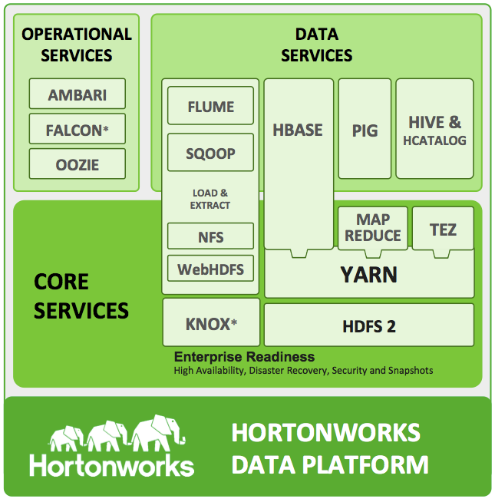
Source: http://hortonworks.com

Slide 79
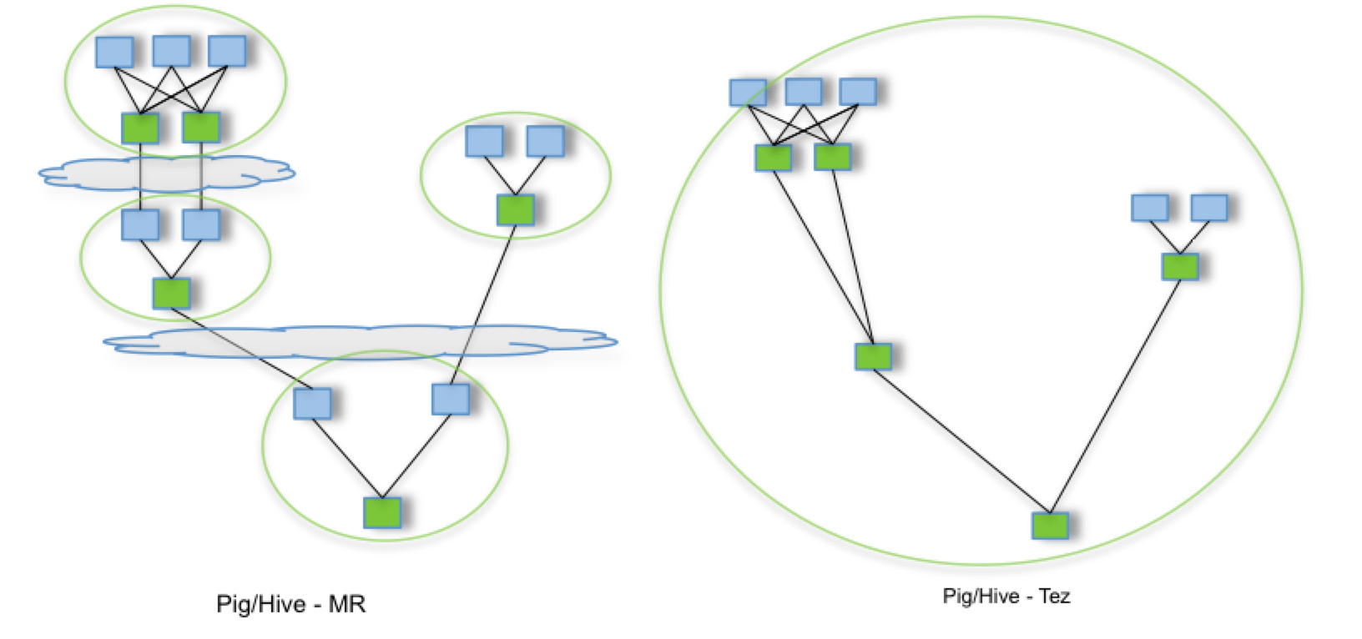
What is Tez? – DAG execution engine
source:http://tez.incubator.apache.org
Notes:
Hive on tez
pig on tez
MR on tez
xyz on tez

Slide 80
What is Oozie?
A server based Workflow Engine
Oozie runs workflow jobs with Map/Reduce and Pig action nodes
A workflow is a collection of actions arranged in a control dependency DAG (Directed Acyclic Graph)
Oozie workflows definitions are written in hPDL (a XML Process Definition Language)

Slide 81
An Oozie Workflow
M/R
streaming
job
OK
start
FS job (mkdir)
OK
fork
join
Pig
job
decision
OK
MORE
ERROR
ERROR
M/R
job
ERROR
ENOUGH
kill
ERROR
OK
ERROR
ERROR
Java Main
end
OK
FS job
(chmod)
OK

Slide 82
Oozie Workflow Constructs
start
end
Kill
fork
join
decision
OK
Actions
map-reduce | pig | streaming
sub-workflow | pipes | java
action
ERROR

Slide 83
Oozie Map-Reduce Wordcount Workflow
<workflow-app name=’wordcount-wf’>
<start to=‘wordcount’/>
<action name=’wordcount'>
<map-reduce>
<job-tracker>foo.com:9001</job-tracker>
<name-node>hdfs://bar.com:9000</name-node>
<job-xml>wordcount.xml</job-xml>
<configuration>
<property>
<name>mapred.input.dir</name>
<value>${inputDir}</value>
</property>
<property>
<name>mapred.output.dir</name>
<value>${outputDir}</value>
</property>
</configuration>
</map-reduce>
<ok to=’end'/>
<error to=’kill'/>
</action>
<kill name=‘kill’/>
<end name=‘end’/>
</workflow-app>
Start
Start
M-R
wordcount
OK
End
ERROR
Kill
Defines M/R, K/V classes,
etc.

Slide 84
Components needed to launch workflow
Oozie Server
HDFS
e.g., /user/your_id/oozie
G/W
workflow.xml
lib directory
JAR and so files
pig script
etc
.properties file
oozie.wf.application.path =hdfs://axoniteblue-nn1.blue.ygrid.yahoo.com:8020/user/your_id/oozie/
Other parameters;
JobTracker = ****
NameNode = ****
InputDir = ****

Slide 85
Components needed to launch workflow
Oozie Server
Run Workflow Job
$ oozie job run -config job.properties -oozie http://oozieserver.com:4080/oozie/
Workflow ID: 00123-123456-oozie-wrkf-W
Check Workflow Job Status
$ oozie job info 00123-123456-oozie-wrkf-W -oozie http://oozieserver.com:4080/oozie/
----------------------------------------------
Workflow Name: test-wf
App Path: hdfs://namenode.**.com:8020/user/your_id/oozie/
Workflow job status [RUNNING]
...
----------------------------------------------
Launcher
.properties file

Slide 86
Zoo Keeper
A distributed coordination service
Simple and robust
High performance, tuned for read-dominant work loads
Start with file system API with the additions of
Ordered updates and strong persistence guarantees
Conditional updates
Watches for data changes
Ephemeral nodes
Generated file names
Java and C clients available
86
Notes:
86

Slide 87
HBase
Column-oriented DB.
Goal is to handle large DBs – billions of rows x millions of columns, atop commodity hardware.
Built on HDFS.
Other similar efforts:
Amazon’s SimpleDB
Hypertable
Cassandra

Slide 88
Hive: Data Warehousing and Analytics on Hadoop
Large installed base of SQL users
Map reduce is for ultra geeks
Much easier to write SQL queries
Analytics SQL queries translate really well to Map Reduce
Files as insufficient data management abstraction
Tables, Schemas, Partitions, Indices
Metadata allows discovery, optimization and browsing
Love the programmability of Hadoop
Hate that RDBMS is closed

Slide 89
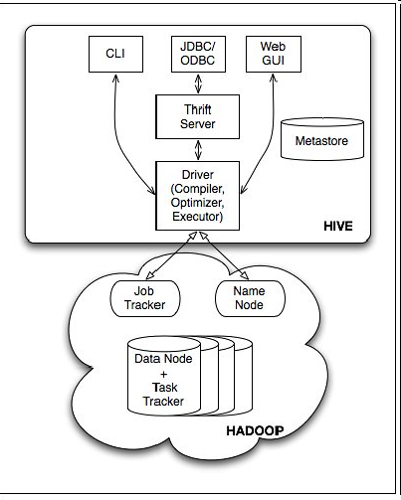
Hive Architecture

Slide 90
Hive Query example
hive>select key, count(1) from kv1 where key > 100 group by key;
vs.
$cat > /tmp/reducer.sh
uniq –c | awk ‘{print $2”\t”$1}’
$cat > /tmp/map.sh
awk –F ‘\001’ ‘{if ($1> 100) print $1}’
$bin/hadoop jar contrib/hadoop-streaming.jar -input /user/hive/warehouse/kv1 –mapper map.sh –reduce reducer.sh –file /tmp/reducer.sh –file /tmp/map.sh –output /tmp/result –numReduceTasks 1
$bin/hadoop dfs –cat /tmp/results/part-*

Slide 91
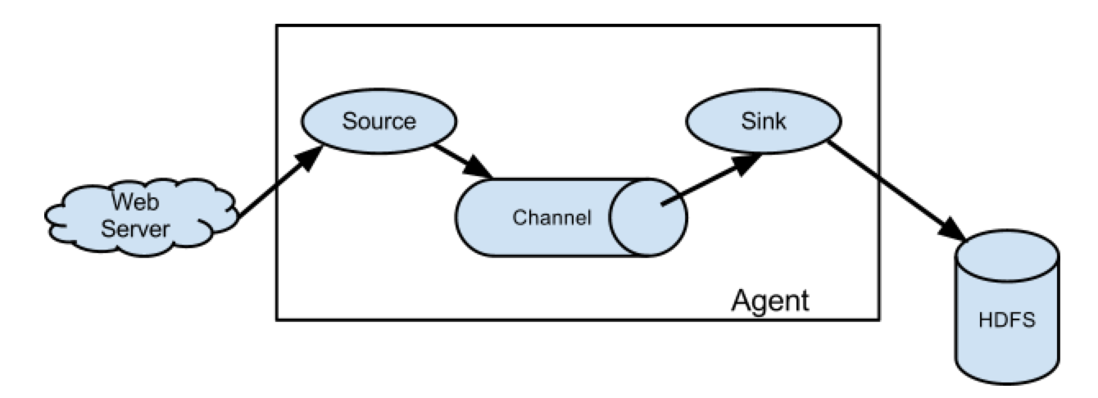
Apache Flume
Source: http://flume.apache.org

Slide 92
Flume Configuration Example
# example.conf: A single-node Flume configuration
# Name the components on this agent
a1.sources = r1
a1.sinks = k1
a1.channels = c1
# Describe/configure the source
a1.sources.r1.type = netcat
a1.sources.r1.bind = localhost
a1.sources.r1.port = 44444
# Describe the sink
a1.sinks.k1.type = logger
# Use a channel which buffers events in memory
a1.channels.c1.type = memory
a1.channels.c1.capacity = 1000
a1.channels.c1.transactionCapacity = 100
# Bind the source and sink to the channel
a1.sources.r1.channels = c1
a1.sinks.k1.channel = c1
Source: http://flume.apache.org

Slide 93
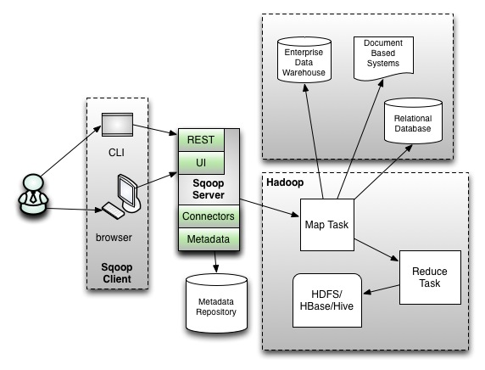
Apache Sqoop
What is it?
Relational Database -> Hadoop
Hadoop -> Relational Database
Source: https://blogs.apache.org/sqoop/entry/apache_sqoop_highlights_of_sqoop

Slide 94
What is Spark?
Fast and Expressive Cluster Computing System Compatible with Apache Hadoop
Up to 10× faster on disk, 100× in memory
2-5× less code
Efficient
Usable
General execution graphs
In-memory storage
Rich APIs in Java, Scala, Python
Interactive shell
Notes:
Generalize the map/reduce framework

Slide 95
Key Concepts
Write programs in terms of transformations on distributed datasets
Resilient Distributed Datasets
Collections of objects spread across a cluster, stored in RAM or on Disk
Built through parallel transformations
Automatically rebuilt on failure
Operations
Transformations (e.g. map, filter, groupBy)
Actions (e.g. count, collect, save)
Notes:
RDD ➔ Colloquially referred to as RDDs
(e.g. caching in RAM)
Lazy operations to build RDDs from other RDDs
Return a result or write it to storage

Slide 96

Example: Log Mining
Load error messages from a log into memory, then interactively search for various patterns
Base RDD
Transformed RDD
Cache 1
lines = spark.textFile(“hdfs://...”)
errors = lines.filter(lambda s: s.startswith(“ERROR”))
messages = errors.map(lambda s: s.split(“\t”)[2])
messages.cache()
results
Worker
tasks
Block 1
Driver
Action
messages.filter(lambda s: “mysql” in s).count()
Cache 2
messages.filter(lambda s: “php” in s).count()
Worker
Cache 3
. . .
Full-text search of Wikipedia
60GB on 20 EC2 machine
0.5 sec vs. 20s for on-disk
Worker
Block 2
Block 3
Notes:
Add “variables” to the “functions” in functional programming

Slide 97
Language Support
Python
lines = sc.textFile(...) lines.filter(lambda s: “ERROR” in s).count()
Standalone Programs
Python, Scala, & Java
Interactive Shells
Python & Scala
Performance
Java & Scala are faster due to static typing
…but Python is often fine
Scala
val lines = sc.textFile(...) lines.filter(x => x.contains(“ERROR”)).count()
Java
JavaRDD<String> lines = sc.textFile(...); lines.filter(new Function<String, Boolean>() { Boolean call(String s) { return s.contains(“error”); } }).count();

Slide 98
Apache Storm
Guaranteed data processing
Horizontal scalability
Fault-tolerance
No intermediate message brokers!
Higher level abstraction than message passing
“Just works”
Hadoop of real time streaming jobs
Built by Backtype, bought by Twitter
Available as open source through Apache

Slide 99

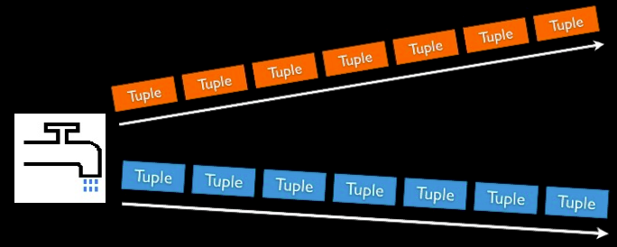
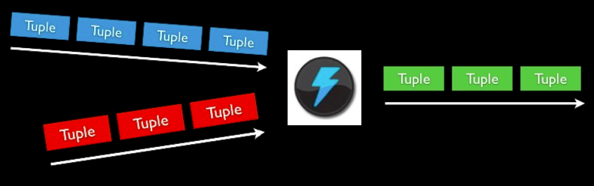
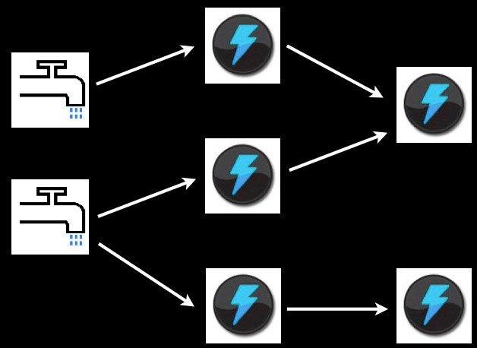
Storm Concepts
Streams
Unbounded sequence of tuples
Spout
Source of Stream
E.g. Read from Twitter streaming API
Bolts
Processes input streams and produces new streams
E.g. Functions, Filters, Aggregation, Joins
Topologies
Network of spouts and bolts

Slide 100
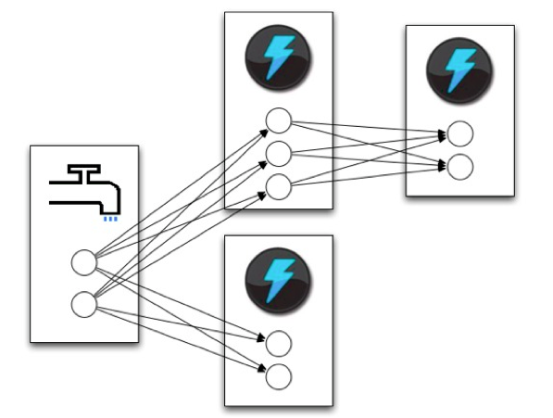
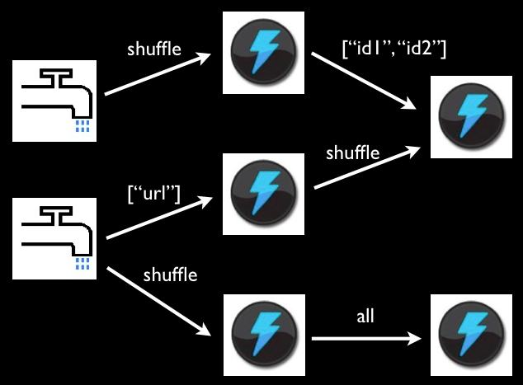
Storm Tasks
When a tuple is emitted, which task does it go to? User programmable:
Shuffle grouping: pick a random task (but with load balancing)
Fields grouping: consistent hashing on a subset of tuple fields
All grouping: send to all tasks
Global grouping: pick task with lowest id
Shuffle or Local grouping: If there is a local bolt (in the same worker process) use it otherwise use shuffle.

Slide 101
Example: WordCount in Storm
TopologyBuilder builder = new TopologyBiulder();
builder.setSpout(“spout”, new KestrelSpout(“kestrel.twitter.com”,
22133, “sentence_queue”, new StringScheme()),5);
builder.setBolt(“split”, new SplitSentence(), 8).shuffleGrouping(“spout”);
builder.setBolt(“count”, new WordCount(), 12)
.fieldGrouping(“split”, new Fields(“word”));
//===============================================================
public static class SplitSentence extends ShellBolt implements IRichBolt {
//Code to split a sentence
}
public static class WordCount implements IBasicBolt{
//Code to count words, have to override the execute function
public void execute(Tuple tuple, BasicOutputCollector collector){
//…
}
}
//================================================================
StormSubmitter.submitTopology(“word-count”, builder.createTopology());
Parallelism Degree
(Number of tasks for a spout or Bolt)

